Slide 1
Personalization, Voice and Image Principles
Chapin
Brinegar
MIT511

Slide 2
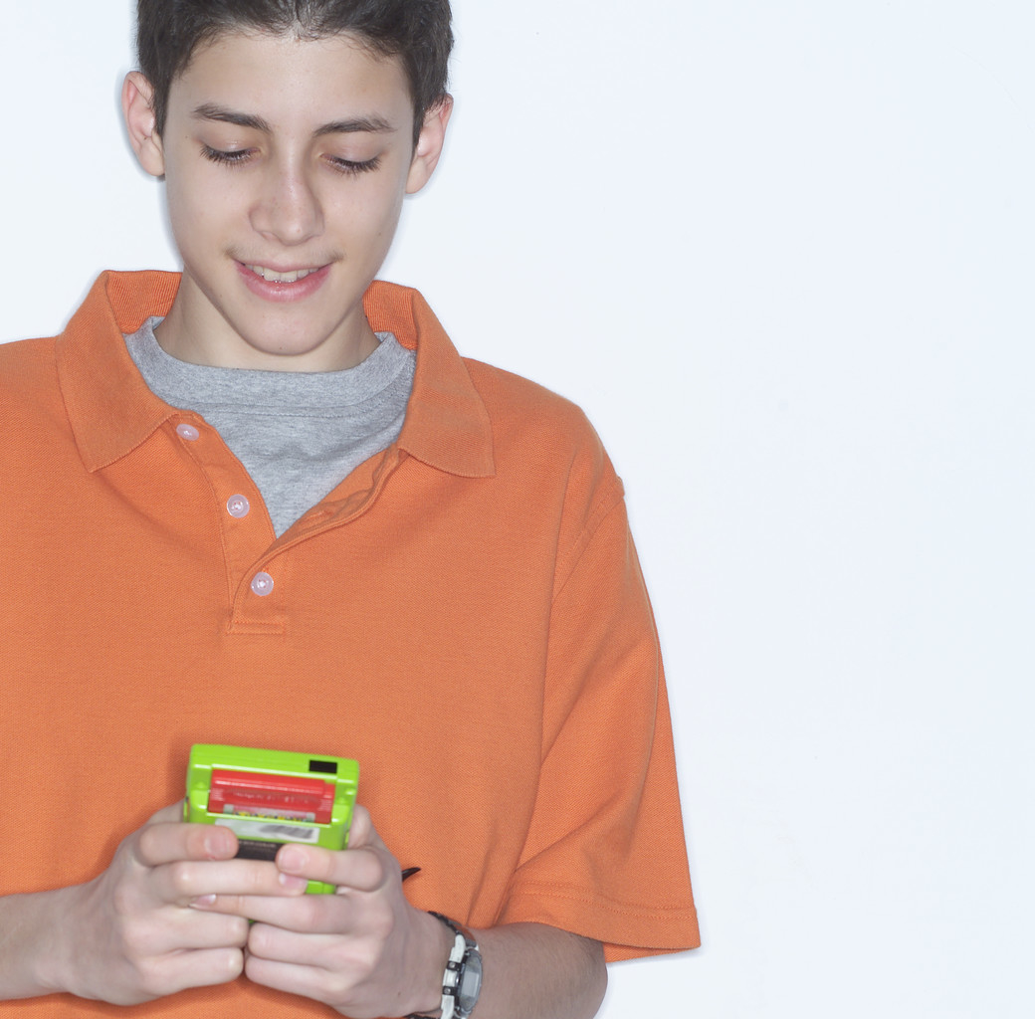
Introduction
Reading, viewing a presentation or playing an interactive game are social events.
Implied conversation between author and learner(s)
Words, Voice and Animation are important!

Slide 3
Introduction
At the end of this presentation, you will be able to:
Define personalization, voice, and image principles
Demonstrate application of these three principles

Slide 4
Personalization Principle
People learn better from multimedia presentations when words are in conversational style rather than formal style.

Slide 5
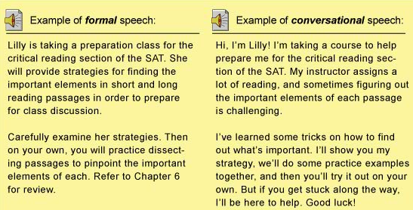
Personalization Principle
Here is an example:
What is different about the second script?

Slide 6
Personalization Principle
How Can We Create This?
By using first person instead of third person
Use words like: You, Your, I, Me, We
Create more user friendly tone
Talk to learners instead of talking at them
(Pages 245-246 in text have more examples)

Slide 7
Personalization Principle
Advantages:
Encourages learners to try harder to comprehend
Primes activation of social responses
Strengthens cognitive processes
Increases quality of learning outcome

Slide 8
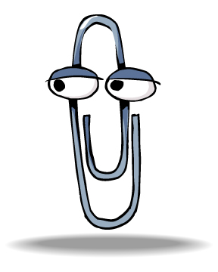
Personalization Principle
Disadvantages:
Adds no new information to material
Can be distracting to learner
Divert attention away from essential information

Slide 9
Personalization Principle
What Does Research Tell Us?
Supported in 11 out of 11 tests
Strong and consistent evidence
People learn on deeper level when presented with text in conversational style
(Pages 249-251 tell more about the experiments conducted)

Slide 10
Personalization Principle
Conditions
Don’t over do it!
Balance with cognitive load
Works best when learner is not familiar with material or “tutor”
Social/Cultural considerations

Slide 11
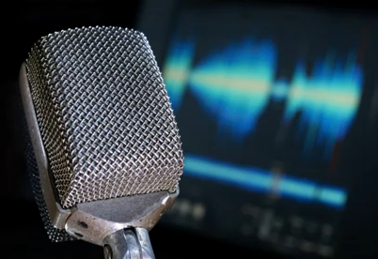
Personalization Principle
Words aren’t the only things that can shape a learning experience….
A person’s voice is also important!

Slide 12
Voice Principle
People learn more deeply when the words in a multimedia message are spoken by a friendly, human voice rather than by a machine voice.

Slide 13
Voice Principle
In addition, people prefer a standard accent as opposed to a foreign one.
Example 1 Example 2 Example 3
Human Voice Computer Voice Computer Voice-Accent

Slide 14
Voice Principle
How Can We Create This?
Friendly tone
Accent known by learner(s)
Human as opposed to computer generated
Combine with conversational style

Slide 15
Voice Principle
What Does Preliminary Research Tell Us?
Humans are sensitive to speech
Better performance with voice principle
Consistent results
There is still a need for more research in this area.
(Pages 256-257 tell more about the experiments conducted)

Slide 16
Voice Principle
Conditions
Works better when learner perceives person’s voice is coming from someone like them
Gender
Race
Ethnicity
Emotional State

Slide 17
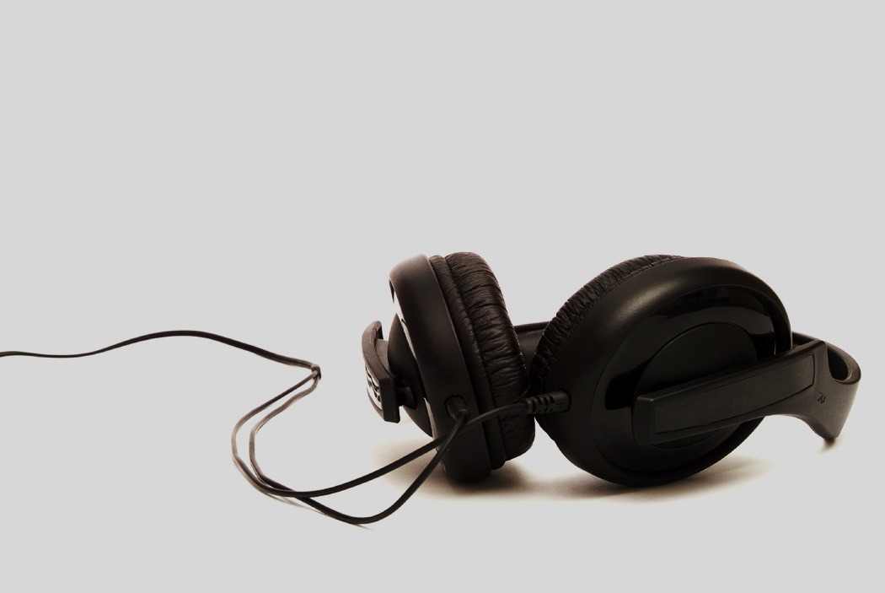
Voice Principle
This is an area that would benefit from further research.

Slide 18
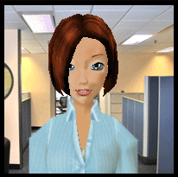
Image Principle
Researchers considered a 3rd element:
Word Choice
Voice
Image
Having the instructor’s image on the screen.
Do You think this makes a difference?

Slide 19
Image Principle
People do not necessarily learn more deeply from a multimedia presentation when the speaker’s image is on the screen.

Slide 20
Image Principle
What Does Research Tell Us?
Only showed slight improvement
No strong and consistent evidence
Images provide little or no pedagogically relevant information
(Pages 259-260 tell more about the experiments conducted)

Slide 21
Image Principle
Conditions
More effective use includes:
Instructor points to relevant portion of a graphic
Instructor directs learner to something

Slide 22
Image Principle
More research is needed to determine if on screen presence of instructor can foster learning.

Slide 23
Summary
Personalization Principle
Applying conversational style
Voice Principle
Using human voice with similar and appropriate accent, tone
3. Image Principle
Using instructor’s image/avatar

Slide 24
Questions?

