Slide 1
Screen Based Controls
Chapin Brinegar
MIT511, Fall 2011

Slide 2
Agenda
What will you learn in this training?
1
Screen Based Controls
6
Proximity
2
Required vs. Optional
7
Data Fields
3
Labels
8
Multiple Responses
4
Case Sensitivity
9
Familiarity
5
Minimizing Entry
10
Other Tips
Chapin Brinegar
MIT511, Fall 2011

Slide 3
Screen Based Controls
What are they?
Used in order to interact with a web site
Commonly used examples:
Push buttons
Radio buttons
Check boxes
Drop down lists
Entry fields
Also known as “Widgets”
Chapin Brinegar
MIT511, Fall 2011

Slide 4
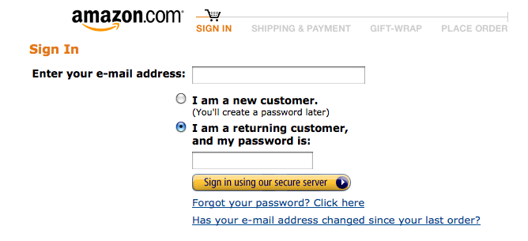
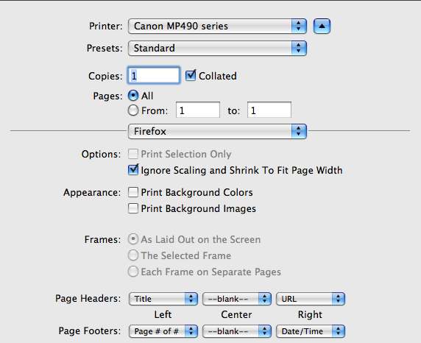
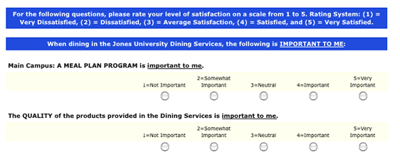
Screen Based Controls
Examples
Chapin Brinegar
MIT511, Fall 2011

Slide 5
Screen Based Controls
Designers should ensure that widgets are used in a conventional manner
Increase performance
Increase accuracy
Decrease time and effort required by user
Chapin Brinegar
MIT511, Fall 2011

Slide 6
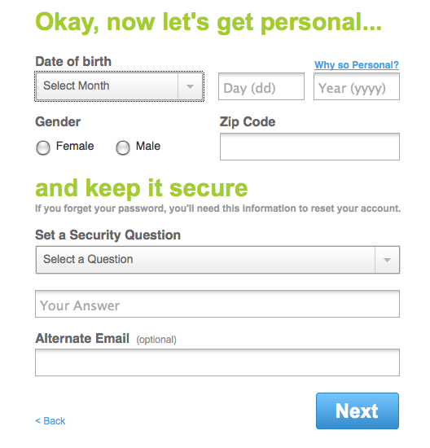
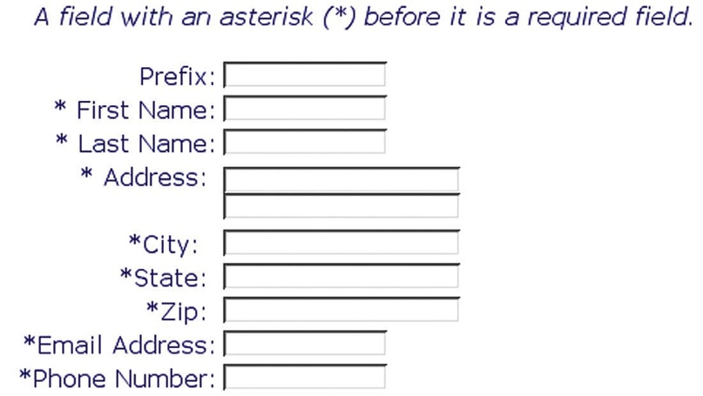
Required vs. Optional
Distinguish clearly between required and optional data entry fields
Some sites will:
Use asterisks to distinguish required (see below)
Write “required” or “optional” (see right)
Use bold text
⬇
➔
Chapin Brinegar
MIT511, Fall 2011

Slide 7
Label Buttons Clearly
Ensure that a pushbutton’s label indicates its action
A label should show what action will be applied when clicked:
Update
Go
Submit
Continue
Cancel
Enter
Home
Next
Previous
Chapin Brinegar
MIT511, Fall 2011

Slide 8
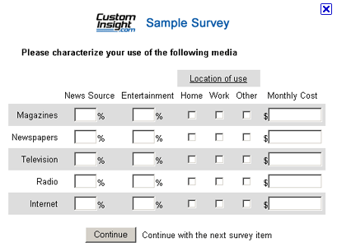
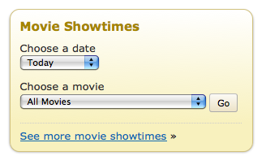
Label Buttons Clearly
Examples
⬆
➔
⬅
Chapin Brinegar
MIT511, Fall 2011

Slide 9
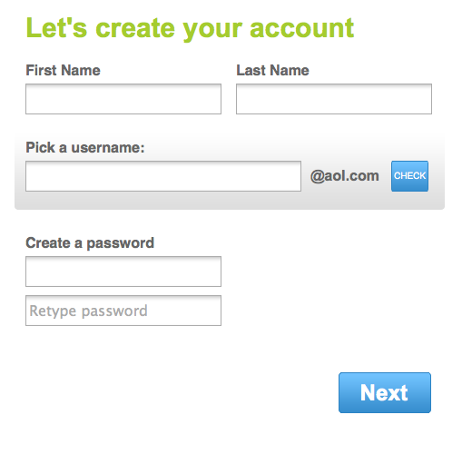
Label Entry Fields Clearly
Display an associated label for each data entry field to help users understand what entries are desired
Labels should be clear, concise and unambiguously define the required entry
Make labels distinctly different from data entries themselves
Don’t use new jargon when labeling data entry fields
Use common terms: male, female, date, quantity, etc.
Chapin Brinegar
MIT511, Fall 2011

Slide 10
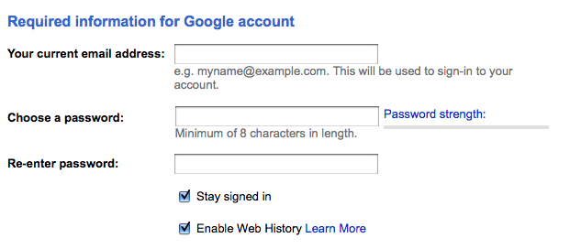
Consistent Labels
Ensure that data entry labels are worded consistently
Labeling Conventions:
Do not use single words/phrases for some labels and short sentences for some
Do not mix nouns and verbs
Labels for data items should be the same across different pages
What is interesting about this label?
Chapin Brinegar
MIT511, Fall 2011

Slide 11
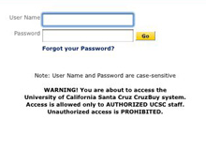
Case Sensitivity
Treat upper and lowercase letters as equivalent
Do not make data entry fields case sensitive unless there is a valid reason
Security, Passwords, etc.
Clearly inform users of case sensitive fields
If possible, show data entered by users
⬅
Chapin Brinegar
MIT511, Fall 2011

Slide 12
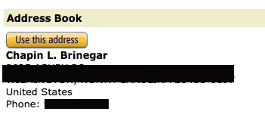
Minimize Entry
Do not require users to enter the same information more than once
Requiring re-entry causes increased possibility of errors
Use “Copy From” or “Same As” option to auto-copy data previously entered
Require users to make as few entries as possible
Amazon asks you to enter your information for your shipping, but can carry it over for payment info.
Chapin Brinegar
MIT511, Fall 2011

Slide 13
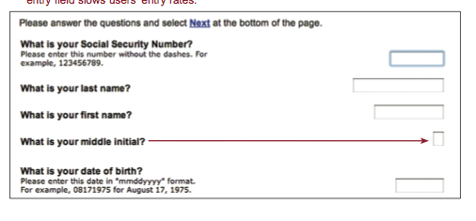
Proximity
Ensure labels are close enough to their associated data entry fields so that users will recognize the label as describing the data entry field
Labels should enable users to relate labels with entries required
Increases speed of entry
Chapin Brinegar
MIT511, Fall 2011

Slide 14
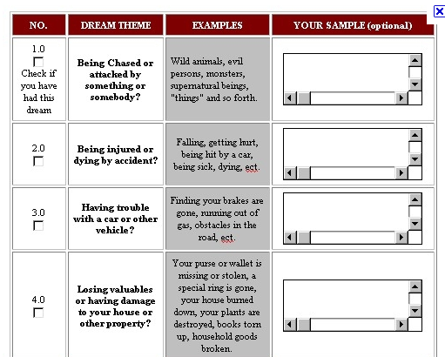
Show them the data!
Create data entry fields that are large enough to show all of the entered data without scrolling
Show users entire entry
Minimize need to scroll or move cursor through fields
Notify user of character limits
Designers must be aware of appropriate length to accommodate data
What’s wrong here??
Chapin Brinegar
MIT511, Fall 2011

Slide 15
Multiple Responses
Provide radio buttons when users need to choose one response from a list of mutually exclusive options.
Assign one radio button as default when appropriate
Radio buttons elicit better performance than drop down lists
Radio buttons are preferred by learners
Never use only 1 radio button, have at least 2
Chapin Brinegar
MIT511, Fall 2011

Slide 16
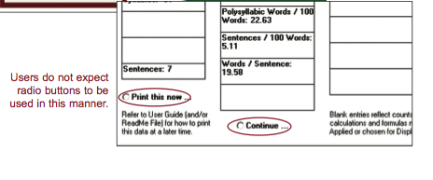
Use Familiar Widgets
Use widgets that are familiar to your users, and employ them in their commonly used manner.
Never assume users are familiar with widgets
Unfamiliar widgets will slow down users
Consider amount of “screen real estate”
Match type of widget with data required
What would be a better widget here?
Chapin Brinegar
MIT511, Fall 2011

Slide 17
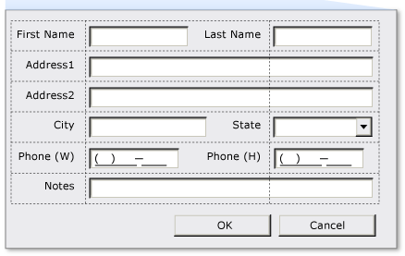
Other Tips
Partition long data items into shorter sections for both data entry and data display
Phone Numbers, Addresses (see right)
Use single data entry method. Don’t make users switch between various types
Prioritize push buttons
Place “Search” button before “Clear Button” (see below)
⬇
⬇
⬇
Chapin Brinegar
MIT511, Fall 2011

Slide 18
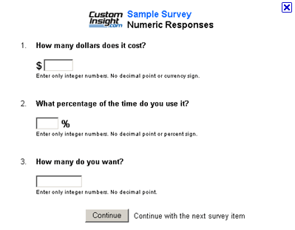
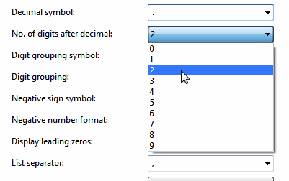
Other Tips continued…
Use check boxes to allow users to select one or more items from a list
Label units of measure
Ex: minutes, ounces, etc. to reduce key stokes (see top right)
Do not limit viewable list box options
Show as many as screen will allow (see bottom right)
Display default values
Offer the number 1 as quantity default (ex: when purchasing an item)
⬇
⬇
⬇
Chapin Brinegar
MIT511, Fall 2011

Slide 19
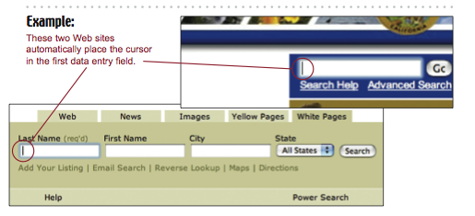
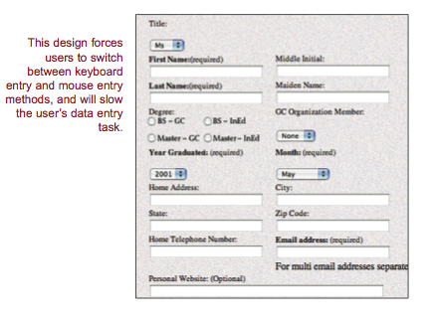
Other Tips continued…
Place cursor in first data entry field
Blinking cursor eliminates mouse movement (see top right)
Ensure double clicking will not cause problems (developers must reduce negative consequences of double clicking)
Use data fields to speed performance
Text entry has proven to be more effective versus selection
Can lead to more errors, so use with caution
Chapin Brinegar
MIT511, Fall 2011

Slide 20
Questions?
Resources Used:
www.usability.gov/pdfs/chapter13.pdf
http://office.microsoft.com/en-us/images/
www.amazon.com
www.campusdining.net
www.custominsight.com
www.imdb.com
www.aol.com
www.microsoft.com
http://www.presentermedia.com/
Chapin Brinegar
MIT511, Fall 2011

