Slide 1
Curriculum Integration
EDN 303
Module 5

Slide 2
Copyright
This presentation is created under the fair use guidelines, and may not be used for any other purposes other than for which it was originally created
The graphics in this presentation are from Thomson Course Technologies
.

Slide 3
Module Objectives
Explain Curriculum, curriculum standards and learning benchmarks.
Explain the importance of integrating technology into the curriculum
Planning for Technology Integration
Getting started at a New School
Curriculum Integration Activities

Slide 4
1 Explain Curriculum, curriculum standards and learning benchmarks

Slide 5
What is Curriculum?
Curriculum is the knowledge, skills, and performance standards students are expected to acquire in particular grade levels
Plan or written document

Slide 6
Curriculum Standards and Benchmarks
Curriculum standard
Defines what a student is expected to know at certain stages of education
Federal and State departments of Education
Benchmark
Specific, measurable learning objective

Slide 7
Curriculum Frameworks or Guides - Documents that school districts provide to the schools to describe curriculum standards and benchmarks for learning

Slide 8
2 Explain the importance of integrating technology into the curriculum

Slide 9
What is Technology Integration?
Combining of all technology parts, such as hardware and software, together with each subject-related area of curriculum to enhance learning
Establish connections between subject matter and the real world
Curriculum should drive the technology

Slide 10
Integrating Technology into the Curriculum
Technology can motivate students and increase class attendance
Has helped students with varying abilities and learning styles and reach diverse learners
Firstly, you must identify what you are trying to accomplish.
Consider the standards and related learning objectives and then identify appropriate technology

Slide 11
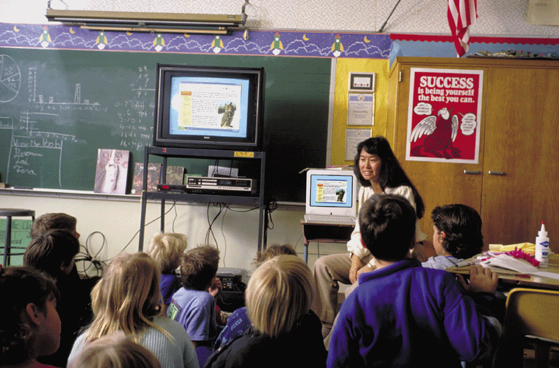
Technology creates valuable learning experiences
Technology is a tool that creates valuable learning experiences for many different types of learners

Slide 12
Role of teachers being shifted
Teachers are shifting from being the dispenser of knowledge to being the facilitator of learning
Students can accomplish learning with the teachers’ assistance
Learning is not just storage of knowledge, but includes problem solving

Slide 13
Barriers to Technology Integration
Lack of teacher training
Lack of administration support
Limited time for teacher planning
Placement of computers in remote locations
Budget constraints
Basic resistance to change by many educators

Slide 16
Technology Integration and the Learning Process
Teachers must understand how technology integration can enhance teaching and learning
Research shows that using technology in classroom motivates students, encourages them to become problem solvers, and creates new avenues to explore information

Slide 17
The Learning Process
Authentic learning
Instructional activities that demonstrate real-life connections by associating the concept being taught with a real-life activity or event
Active learning
Students become active in the learning process
Anchored instruction
Providing a knowledge base on which students can build
Problem-based instruction
Students use the background (anchor) information to solve complex problems
Discovery learning
Inquire-based method for teaching and learning

Slide 18
Technology and the Learning Process
Numerous technology tools to support many types of instruction and learning
Example - Body Works
Allows students to build cognitive scaffold
Encourages students to think in colors, sounds, and animations
The Web
Allows children to experience new educational opportunities
Interaction with others outside of the school

Slide 19
Cooperative learning
Students work in groups to achieve learning objectives
Higher-order thinking skills

Slide 20
Strategies for Teaching with Technology
Best strategy is to put the technology in the hands of trained teachers
Provide consistent application of technology tools to support instructional curriculum area
Give opportunity for students to work with computers and related technologies
Careful planning – district level, school level and classroom level

Slide 21
3 Planning for Technology Integration

Slide 22
Planning for Technology Integration in the Classroom
Decide on most appropriate technology to achieve desired learner outcomes
Preparing the classroom environment

Slide 23
Planning for Technology Integration in the Classroom
One-Computer Classroom
Maximize effectiveness of one computer
Use large screen television for output
Projection screens
Used to introduce topics rather than specific skills

Slide 24
Planning for Technology Integration in the Classroom
Two-Computer Classroom
Develop a strategy to manage both computers
Many questions determine strategy
Will the computers be configured the same?
Web connectivity?
Will students rotate through using one or both computer on a daily basis?
How much time per student?

Slide 25
Planning for Technology Integration in the Classroom
More Than Two Computers
Arrange classroom into learning centers
Use planning criteria mentioned previously

Slide 26
Planning for Technology Integration in the Classroom
Using a Computer Lab
Advantages
One computer per student
Hands-on
Tutorials
Remediation
Cooperative learning
Computer skill instruction
Internet research
Whole class instruction
Integrated learning systems (ILS)

Slide 27
Planning for Technology Integration in the Classroom
Using A Wireless Mobile Lab
Portable cart with wireless notebook computers
Can be transported from one classroom to another

Slide 28
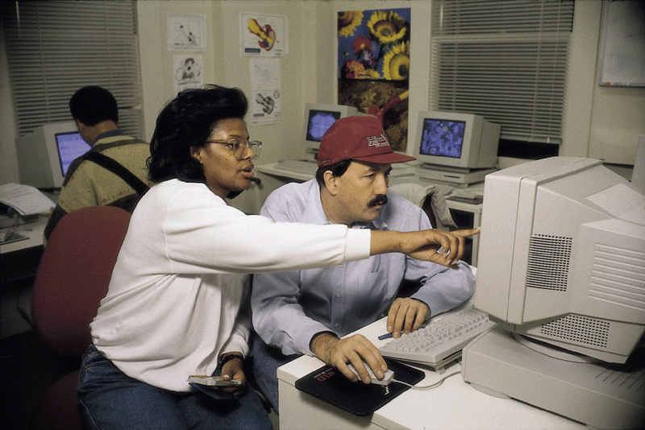
The Role of the School District
Technology plan
Outline of procedure for purchasing equipment and software
Training
Plans often updated every one to three years
Mentorship program
Teaming new teachers with experienced teachers

Slide 29
Planning Lessons with Technology
Must consider skill levels of students
Skill assessment survey
KWL Charts
Instructional planning chart to assist teachers in identifying curriculum objectives
What students Know
What students Want to know
What they will Learn

Slide 31
Instructional Models
A systematic guide for planning instruction or a lesson
The ASSURE Model
Guide for planning and delivering instruction that integrates technologies and media into the teaching process

Slide 32
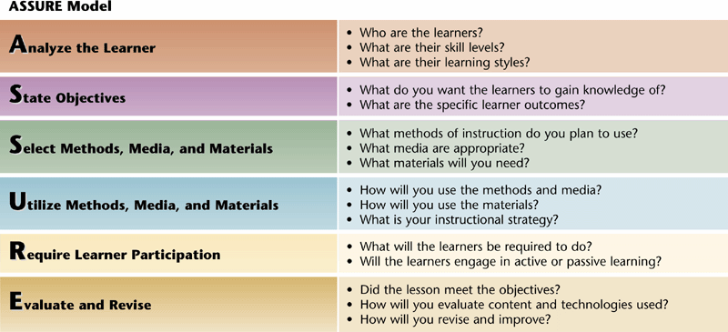
ASSURE Model

Slide 33
Creating an Integrated Learning Environment
Learning centers
Breaks classroom into many types of learning environments

Slide 34
Seven Learning Centers
Mr. Balado’s Project
Seven learning centers
Discovery computer center
Web search center
Modeling center
Great explorers’ library center
Scanning center
Science center
Digital media project center

Slide 35
The Results of Technology Integration
Mr. Balado’s results
Creative projects
Students were actively involved
Higher-level thinking
Improved self-esteem, self-confidence, and writing skills

Slide 36
Integration Strategies
Teachers must become facilitators of learning
Use technology to enhance learning environment
Put technology at point of instruction
Many mixtures of technology

Slide 37
4 Getting Started at a New School

Slide 38
Getting Started at a New School
Information About Technology
Find out who else in the school uses technology
Determine if there is a technology committee
Teacher’s manual
Determine where to get technology support
Technology Training
Does the school offer professional development or in-service training
Talk to your principal, curriculum coordinator, other teachers, or district technology coordinator

Slide 39
Getting Started at a New School
Hardware
Determine how to obtain additional hardware or upgrades
Join the technology committee
Educational grants
Software
Determine what type of software is available
Check the classroom to see what is already installed
Special education requirements
Procedure for obtaining additional software
Is a state bid list available?

Slide 40
Getting Started at a New School
Other Technologies
Media specialist can provide access to other technologies
Find a list of materials in use throughout the district
Technology Supplies
Determine procedure for obtaining additional supplies and parts

Slide 41
5 Curriculum Integration Activities

Slide 42
Curriculum Integration Activities
Curriculum Pages
Strategy for implementing the Internet into the classroom
Teacher created document that contains hyperlinks to teacher-selected-and-evaluated sites that are content and age appropriate

Slide 44
Creating Lesson Plans
Creating Lesson Plans
Must integrate technology into lesson plans
Educator’s Reference Desk
Lesson plans and activities can be found on the Web

Slide 45
Lesson Plan – Language Arts
Language arts integration
Reading, writing, listening, viewing, speaking, and literature
Extra! Extra! Know All About It.

Slide 47
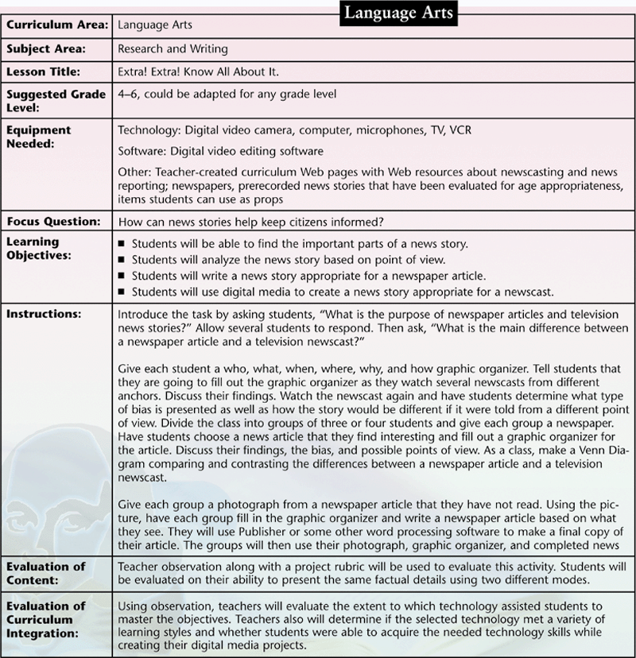

Slide 48
Lesson Plan – Social Studies
Creating Lesson Plans
Social studies integration
History, geography, civics, and economics
What Wonderful Webs We Weave

Slide 51
Lesson Plan - Mathematics
Creating Lesson Plans
Mathematics integration
Basic number concepts, measurements, geometry, algebra, calculus, and data analysis
The Business of Professional Sports

Slide 54
Lesson Plan - Science
Creating Lesson Plans
Science integration
Physical sciences, earth and space sciences, and life sciences
Let’s Think as a Scientist

